Slide 1


How to use this template
Here are some examples to get you started. Want to add more?
Click the “New Slide Button” to insert a slide directly after the one you’re using.
Home Tab>New Slide
To pick the layout, use the drop down menu at the bottom of the “New Slide” button (an arrow)
Or, in the Normal view you can right-click and of the slides at the left with your mouse and select “New Slide”
You may also duplicate and/or overwrite existing slides in this master presentation for additional options
Images in template are placeholders; replace with images relevant to your presentation
UPDATE: For increased contrast try using the newly added Red and Black slide options. Find them here: Home Tab>New Slide.
Techniques for Coordinating Utility Relocation
Presented by: Bill Morris, PE

Slide 2
Process
Right of Way Plans.
Engineering Contacts and Agreements.
Prepare Utility Plans.
Relocation Agreements.
Relocation Construction.

Slide 3
What could go wrong?

Slide 4
Who are utility owners?

Slide 5
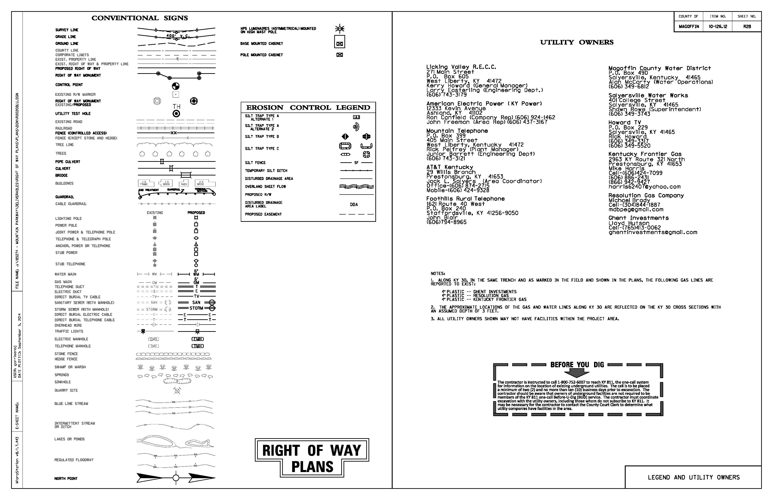

Slide 6
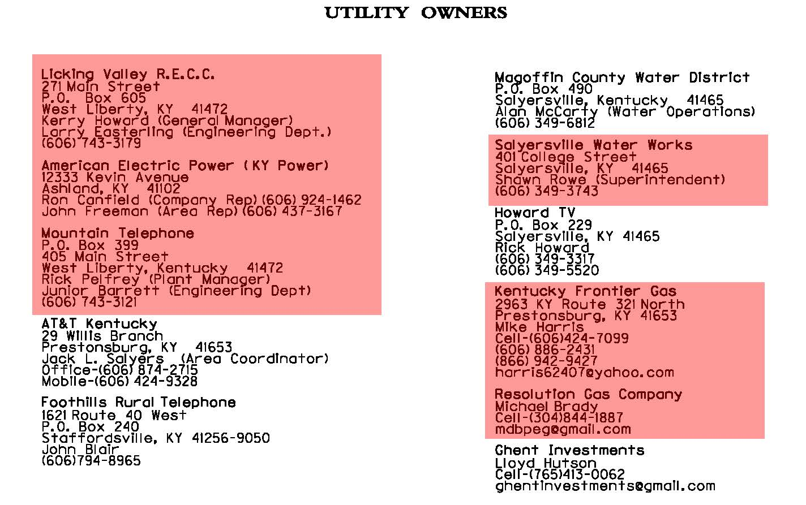

Slide 7
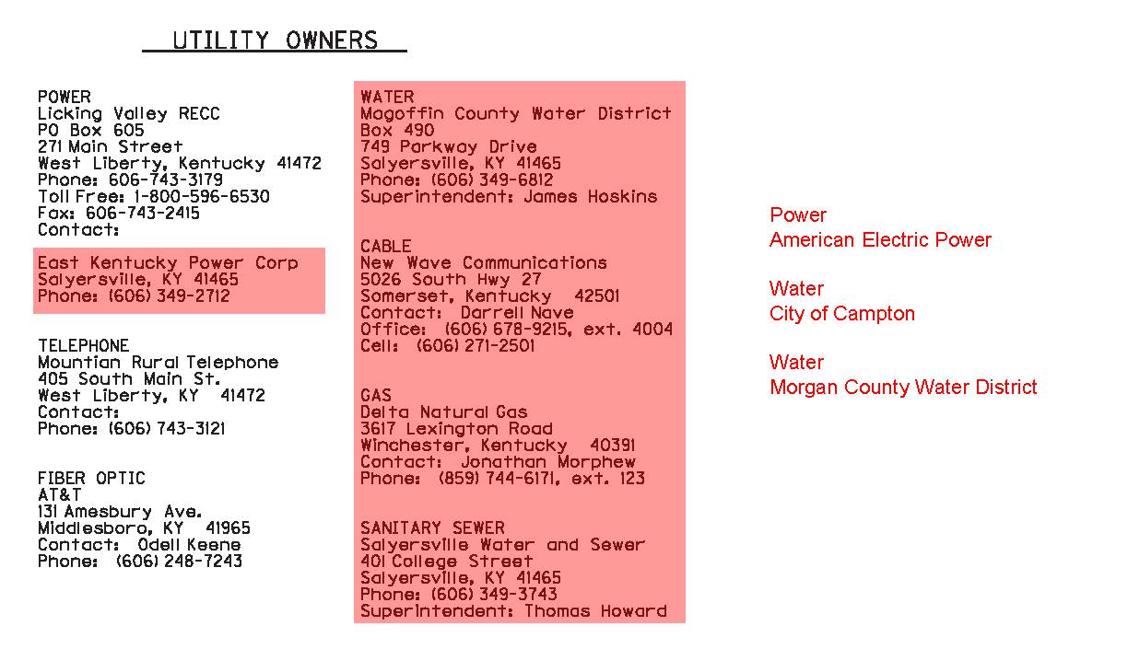

Slide 8
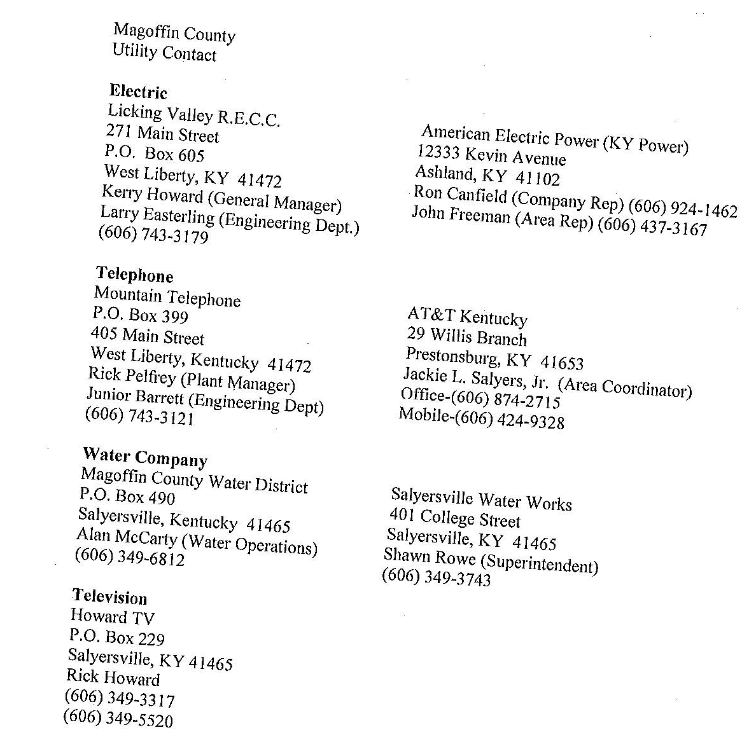

Slide 9
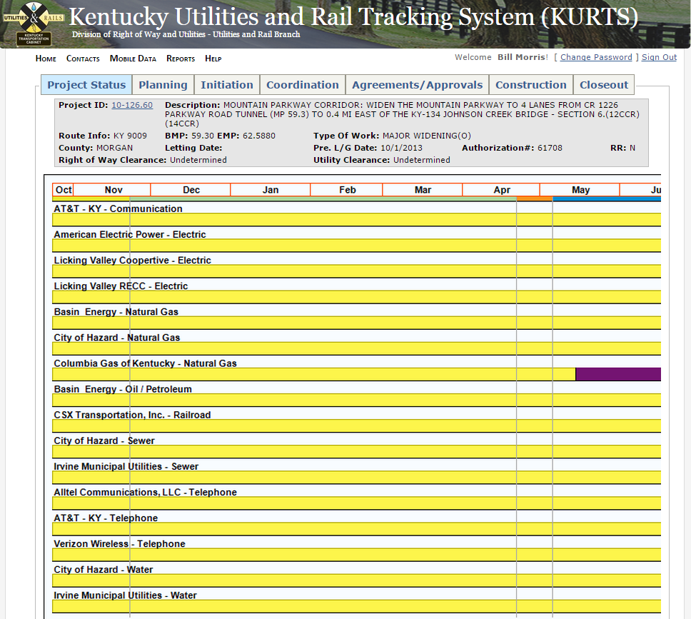

Slide 10
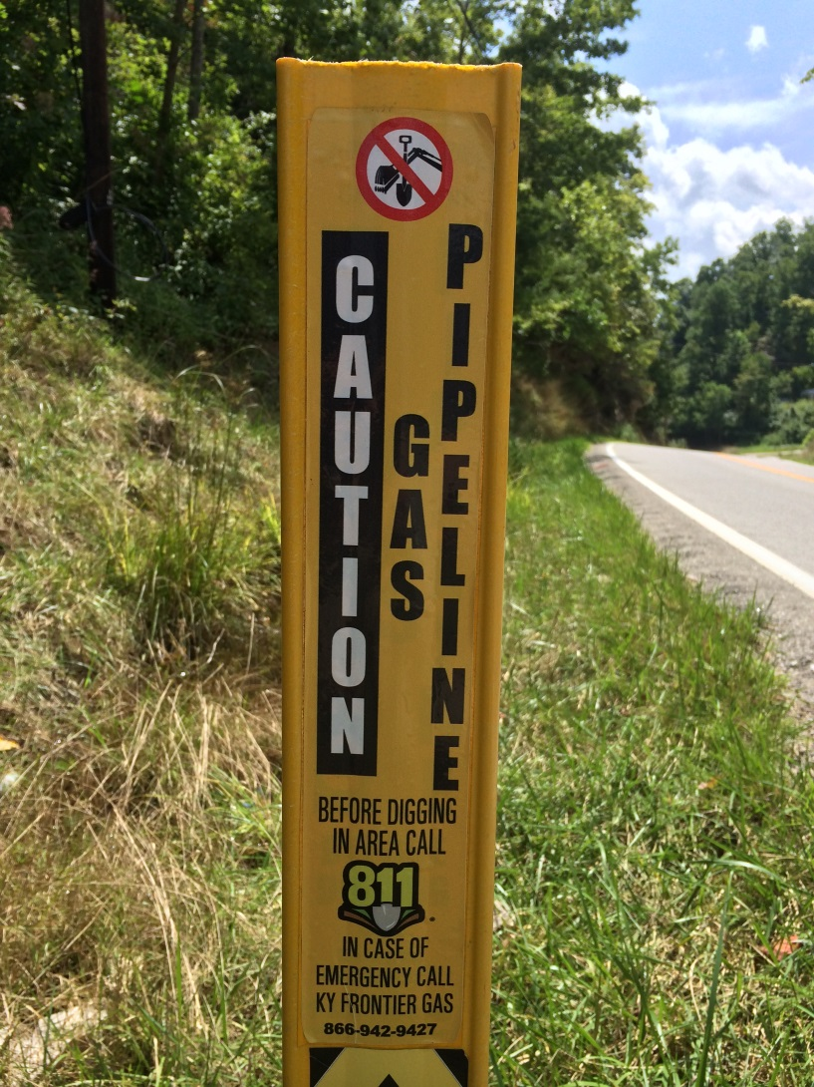
Who Are the Utility Owners?

Slide 11
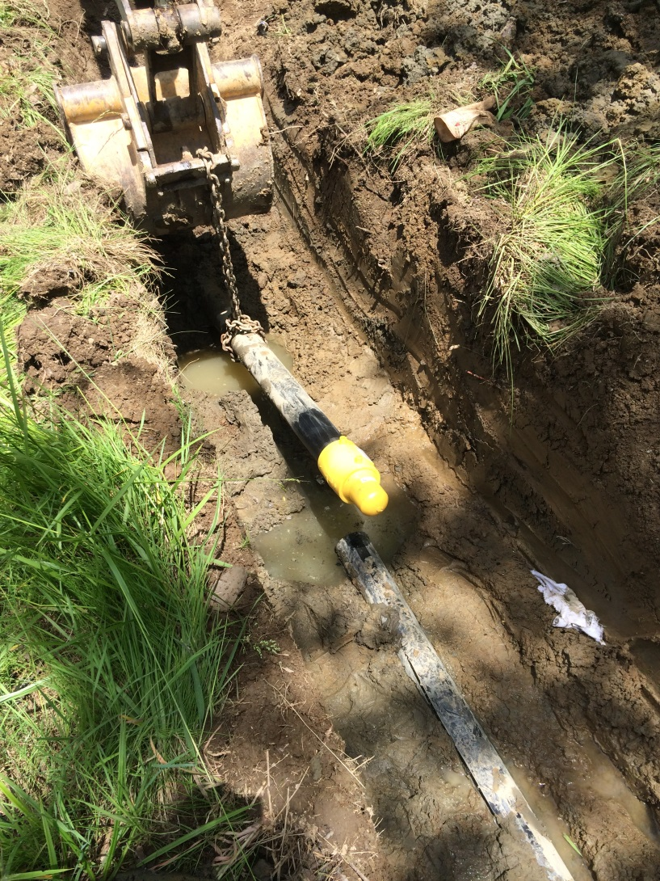
Who Are the Utility Owners?

Slide 12
Who Are the Utility Owners?
Gas company said they were there.
Said they were going to cut & cap line prior to construction.
Said they did cut & cap line.
Said they were not on the project.

Slide 13
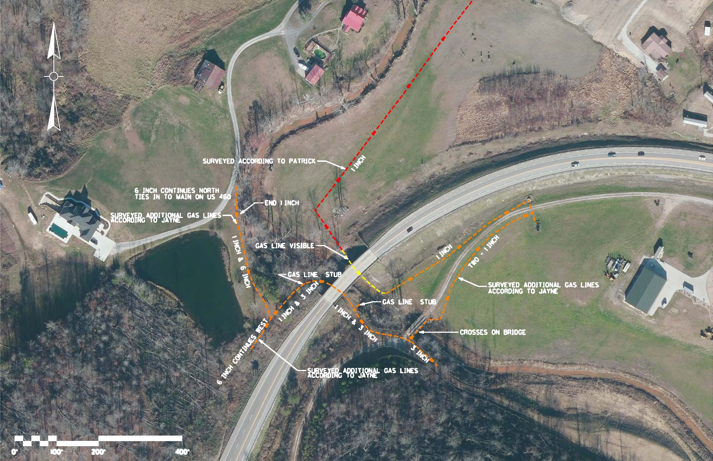
Who Are the Utility Owners?

Slide 14
Who Are the Utility Owners?
Ownership of Utility Company Challenged.

Slide 15
JUM Markups
Right of Way Plans

Slide 16
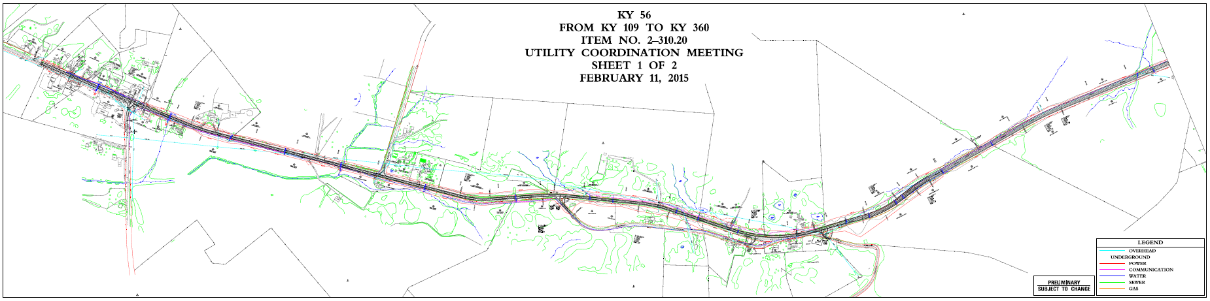
ROW Plans – Utilities Highlighted

Slide 17
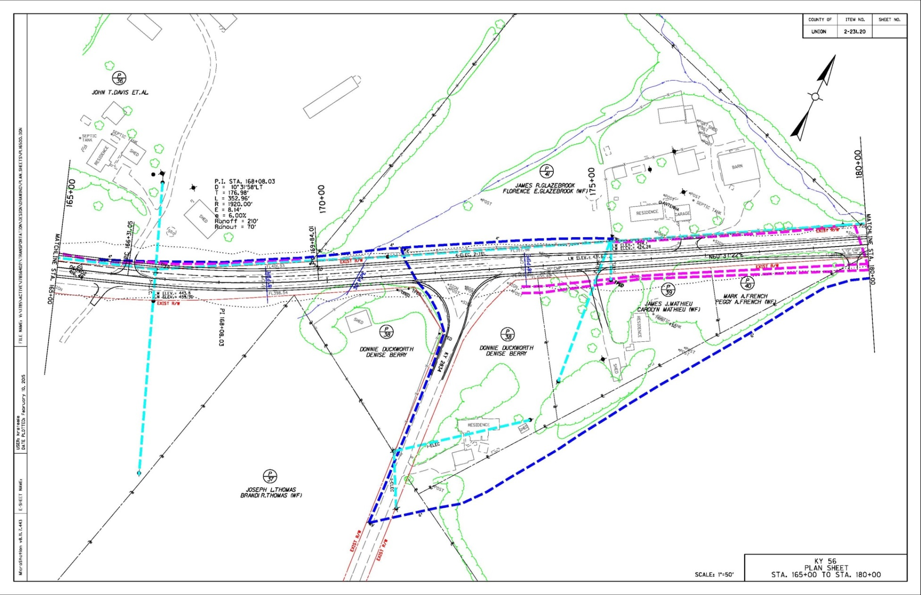
ROW Plans – Utilities Highlighted

Slide 18
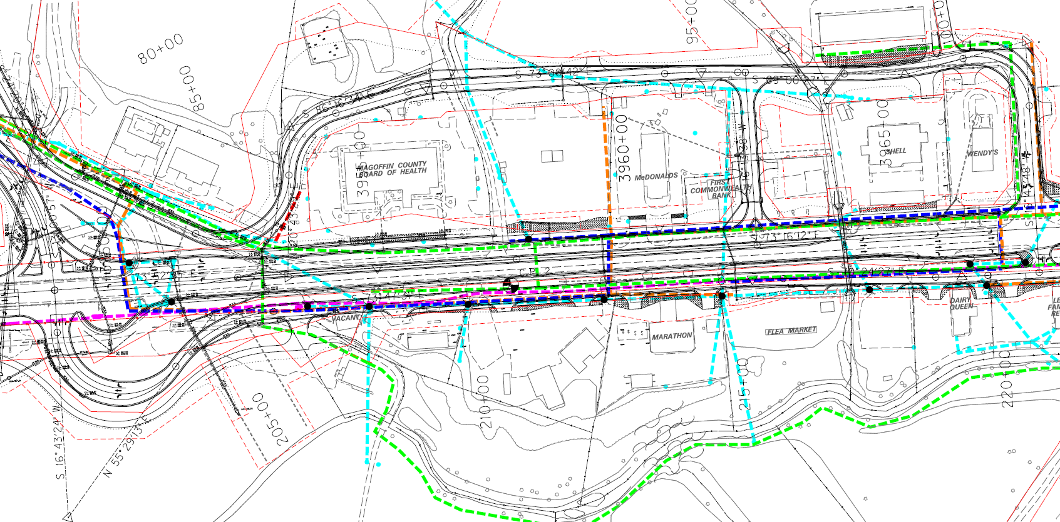
ROW Plans – Utilities Highlighted

Slide 19
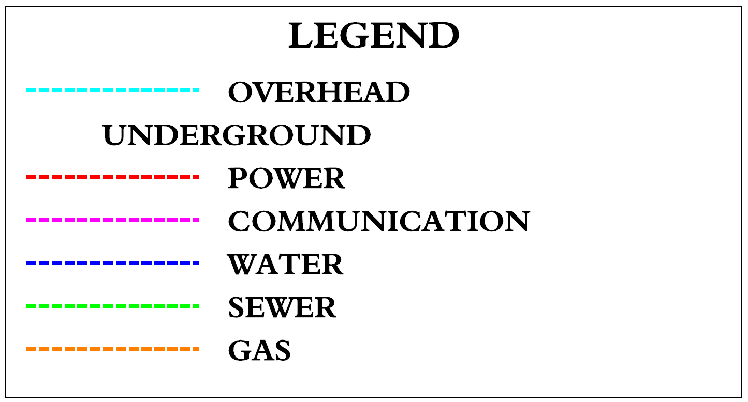
ROW Plans – Utilities Highlighted

Slide 20
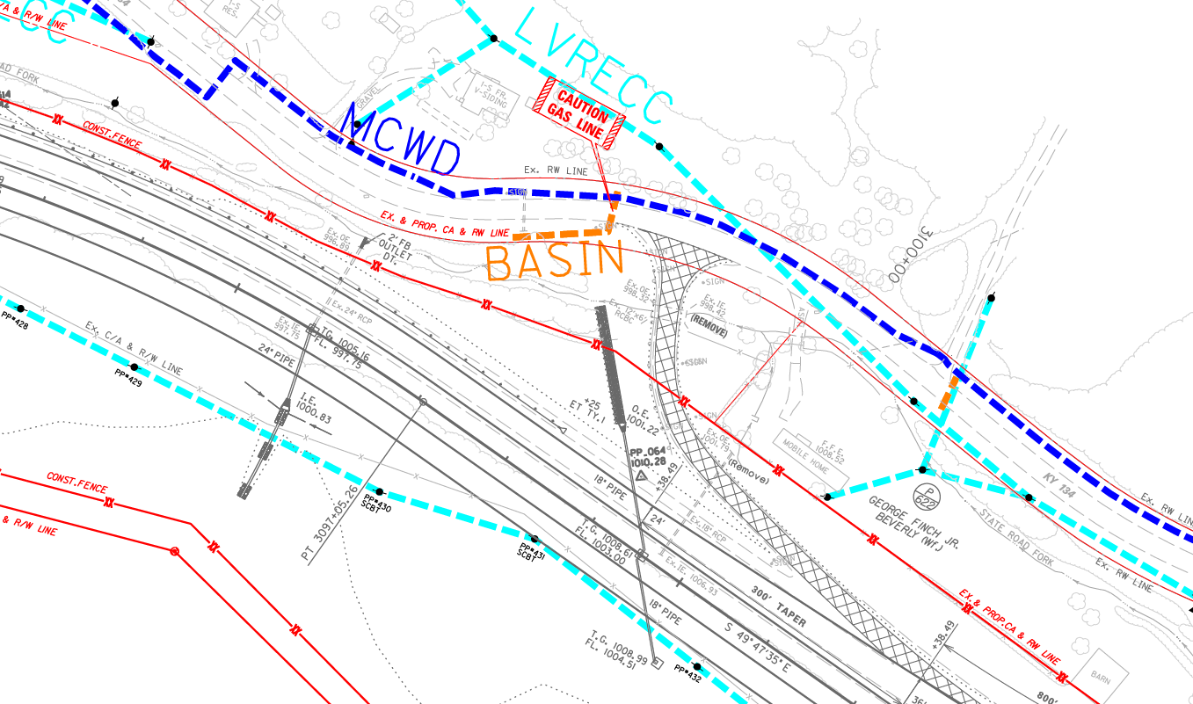
ROW Plans – Incomplete

Slide 21
Right of Way Plans
Identifying the Utility Lines.
Utility Lines incomplete.
Utility Lines incorrect.

Slide 22
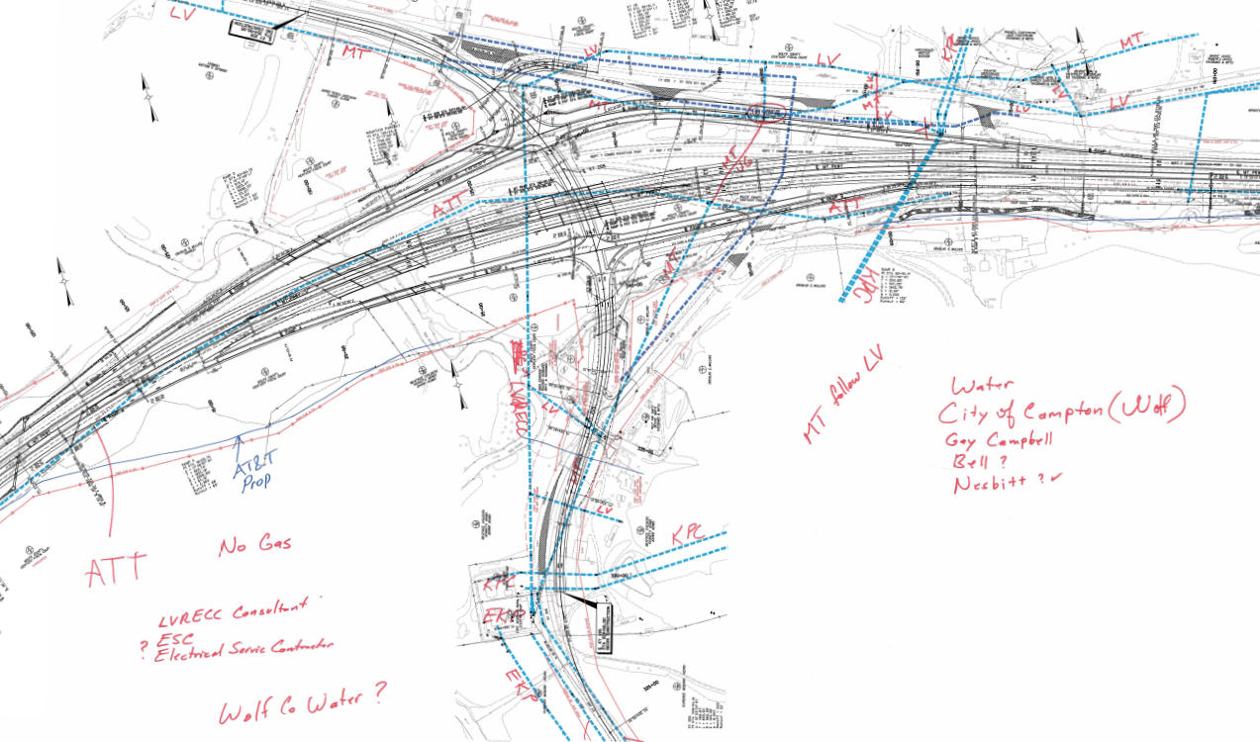
JUM Markups

Slide 23
JUM Markups
Coordination with Design Team

Slide 24
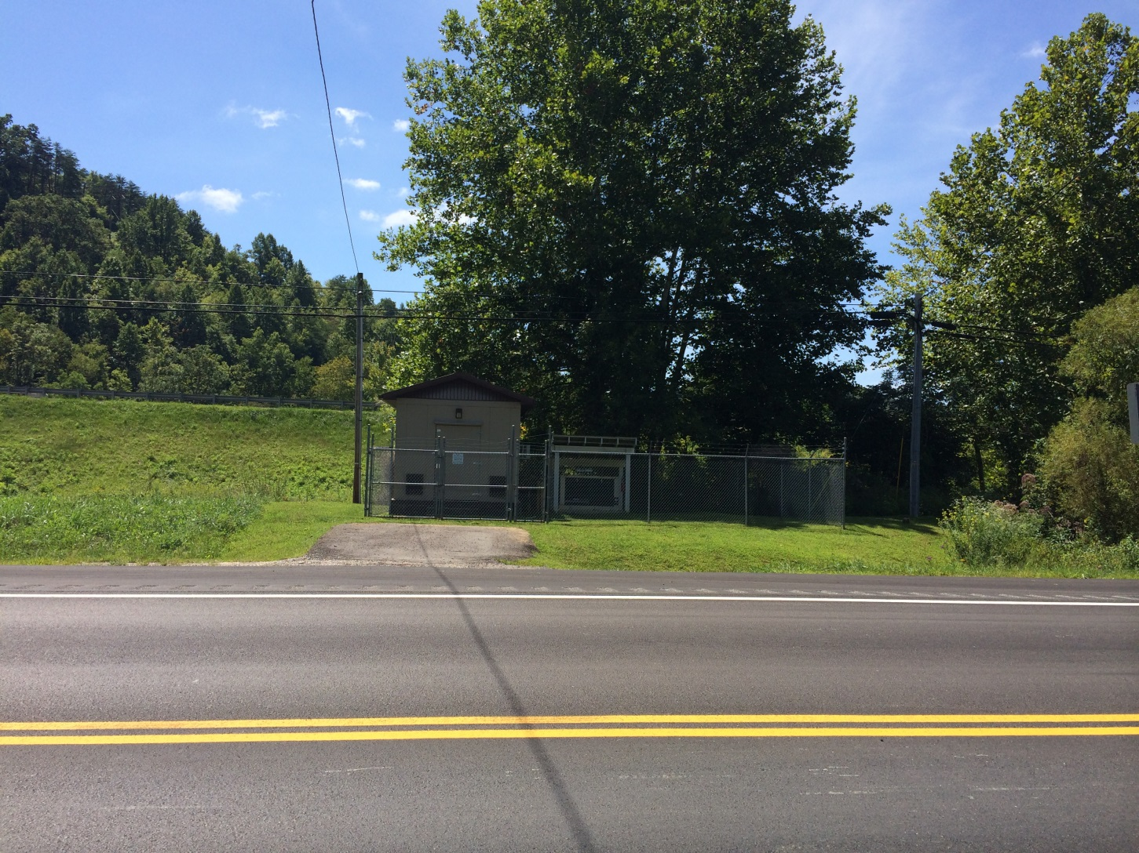
Redesign Ramp to miss Telephone RTS

Slide 25
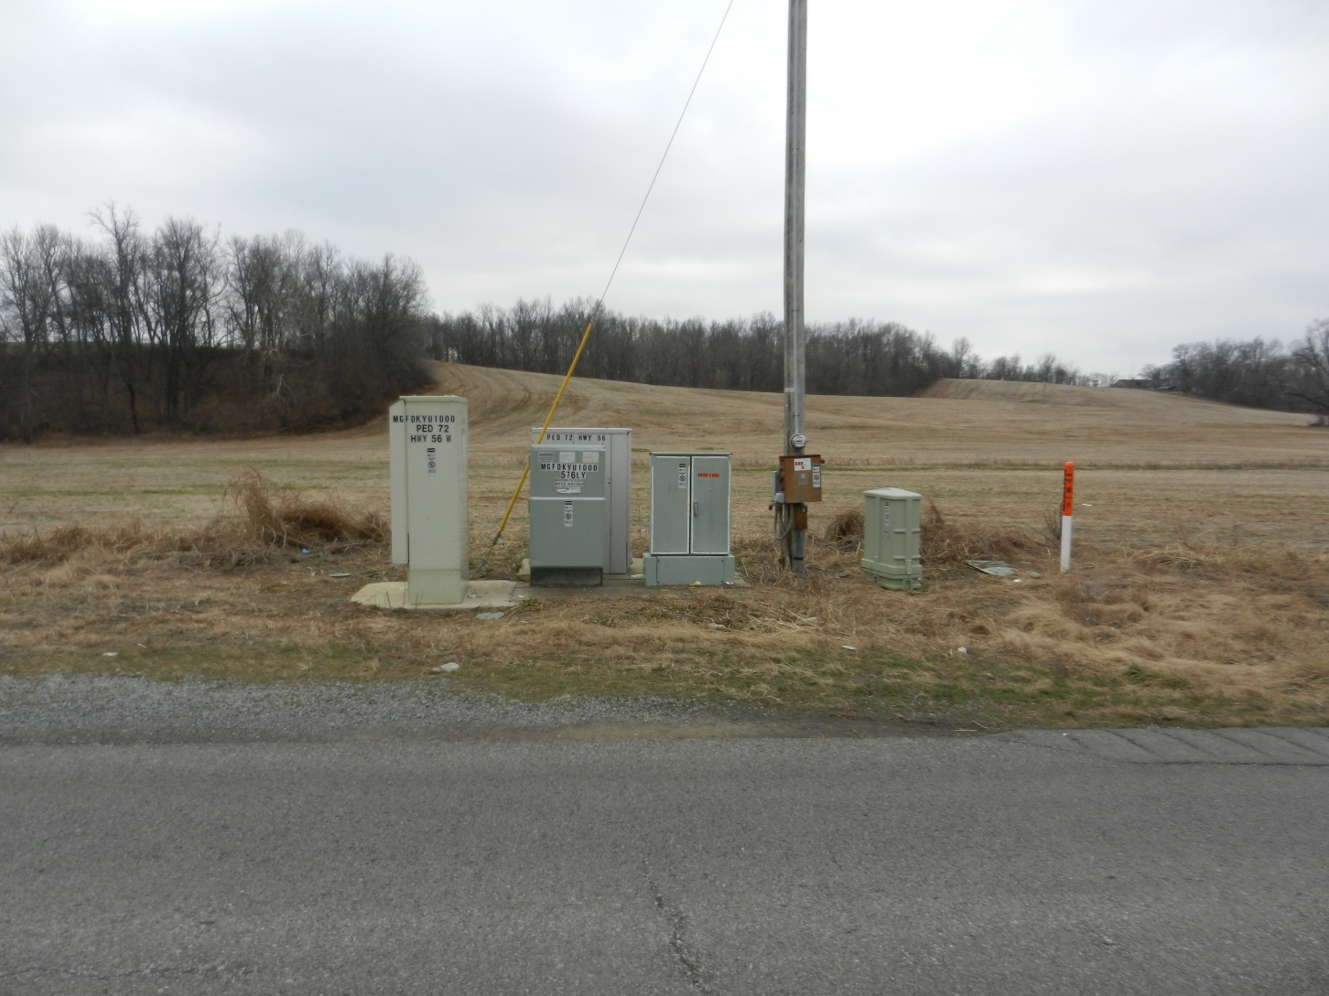
Redesign Mainline to miss RTS

Slide 26
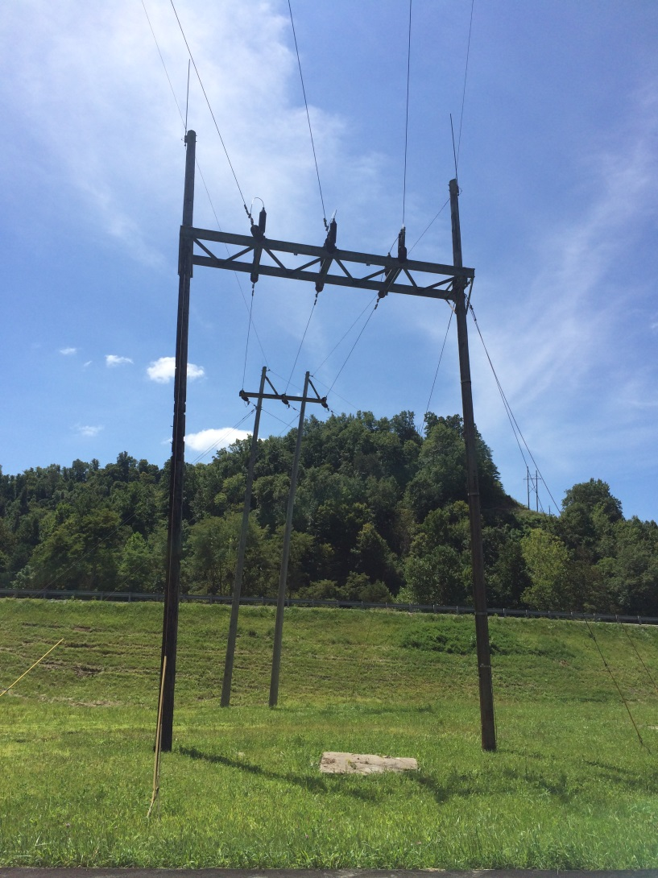
Redesign to Accommodate Transmission Tower

Slide 27
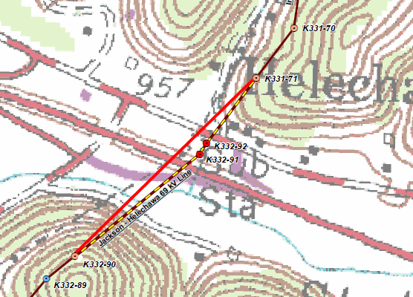
Redesign to Accommodate Transmission Tower

Slide 28
Schedule
Letting
KYTC Priorities
Waiting on other Utility Companies
  Design
  Construction

Slide 29
JUM Markups
Proposed Conflicts

Slide 30
Proposed Conflicts
With Other Utility Companies.
With Cranes.
With Existing Structures.
With Drainage.
Clear Zone.

Slide 31
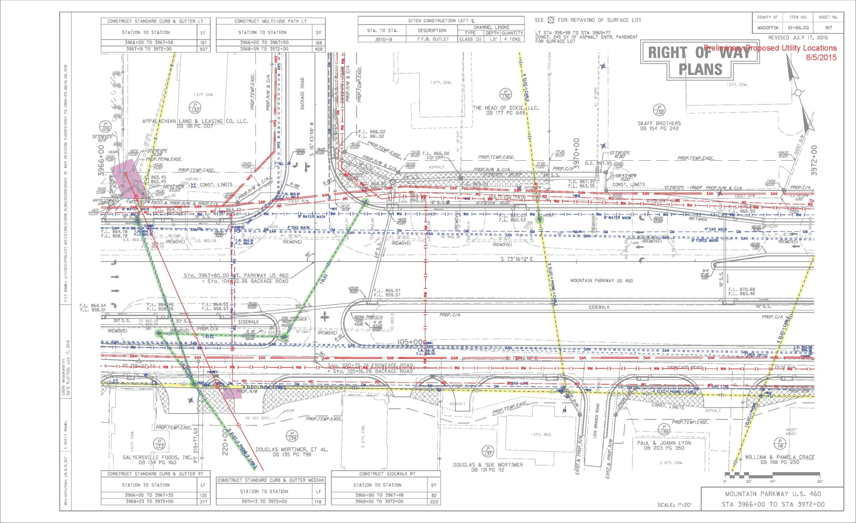
Identify

Slide 32
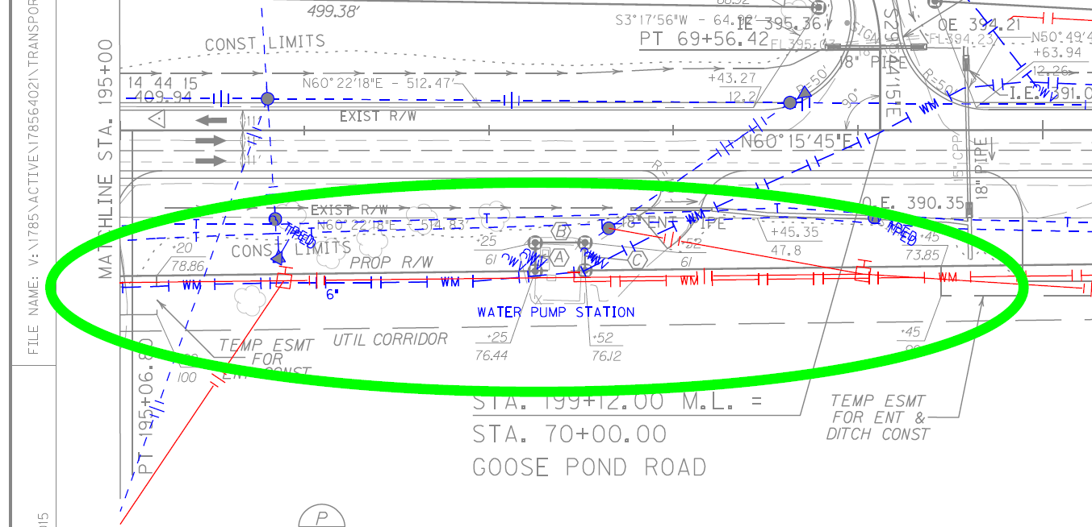
Conflicts with Other Utilities

Slide 33
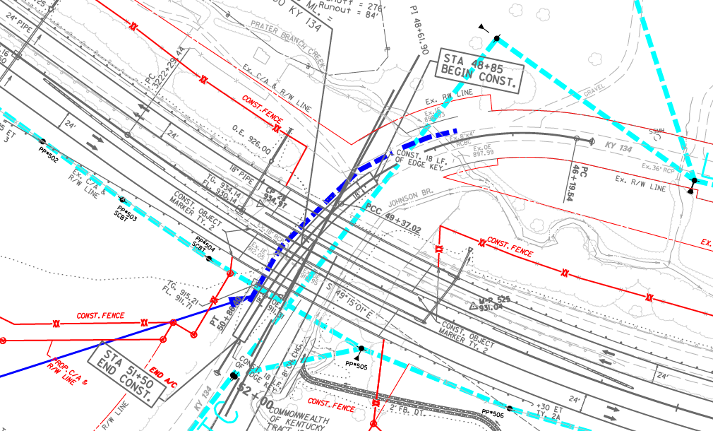
Conflicts with Crane
Conflicts with Crane

Slide 34
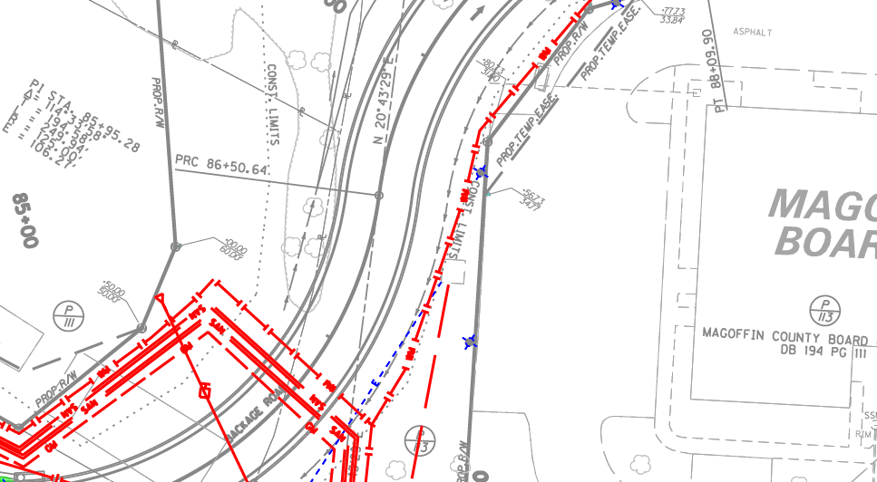
Conflicts with Existing Structures
Conflicts with Crane

Slide 35
Utility Design
Leave existing poles within disturbed limits.
Put proposed poles within disturbed limits.
Put proposed underground within disturbed limits.

Slide 36
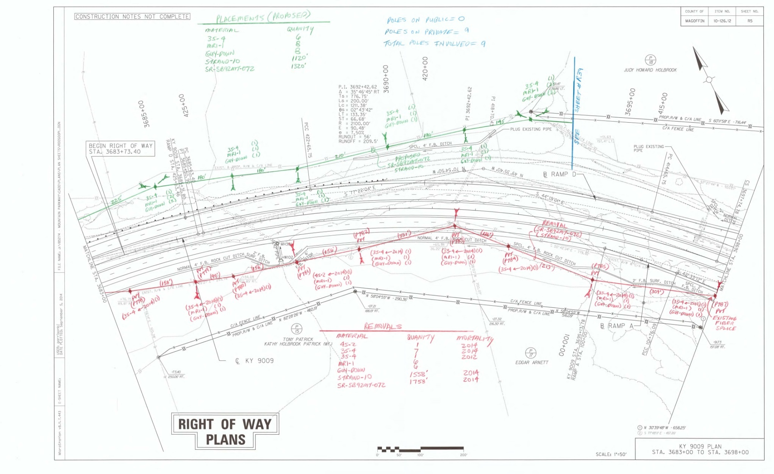
Utility Design

Slide 37
Right of Way
Prioritize Parcels.
Relocation Phases/Sections.
Utility Corridor.
US 62 in Leitchfield.
Newton Pike D/B in Lexington.
KY 56 in Union County.
Who is Acquiring Utility Easements.
Property Owner’s Dilemma.

Slide 38
Construction Schedule
Disasters
  Hurricanes
  Tornados
  Floods
  Ice Storms
Too Wet
Other Oddities

Slide 39
JUM Markups
Get Organized

Slide 40
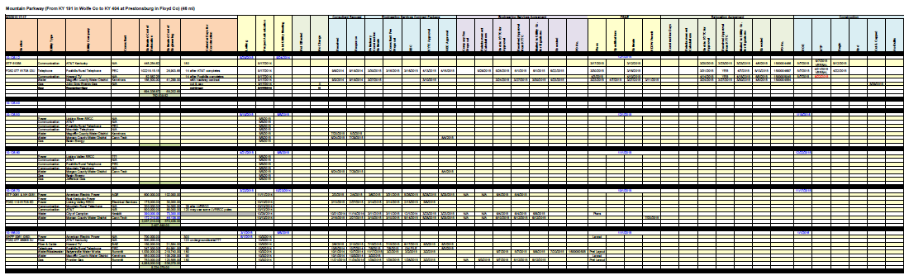
Spreadsheet

Slide 41
General Information

Slide 42
Engineering

Slide 43
Plans & Relocation Agreement

Slide 44
Construction

Slide 45
KURTS
Depository for the documents.
Process.
Keeps track of approvals.

Slide 46
Get the project built.

